Slide 1
College management system
Project Presented by
Valmiki Divya Teja

Slide 2






Technologies Used.! Frontend
Backend

Slide 3
PROJECT SCOPE:
Aim: Providing information about Faculty ,Placements ,Contacts,
Infrastructure , Courses and Student activity club.
Users: Faculty , Students
Functions : Faculty and students can able to “Upload” and “Delete” theire Information.
Requirements : Register by using “username” and “password”.

Slide 4
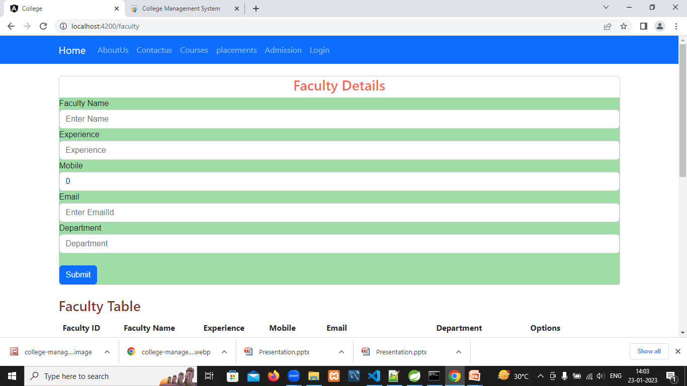
Screenshots: Faculty Registration Form:

Slide 5
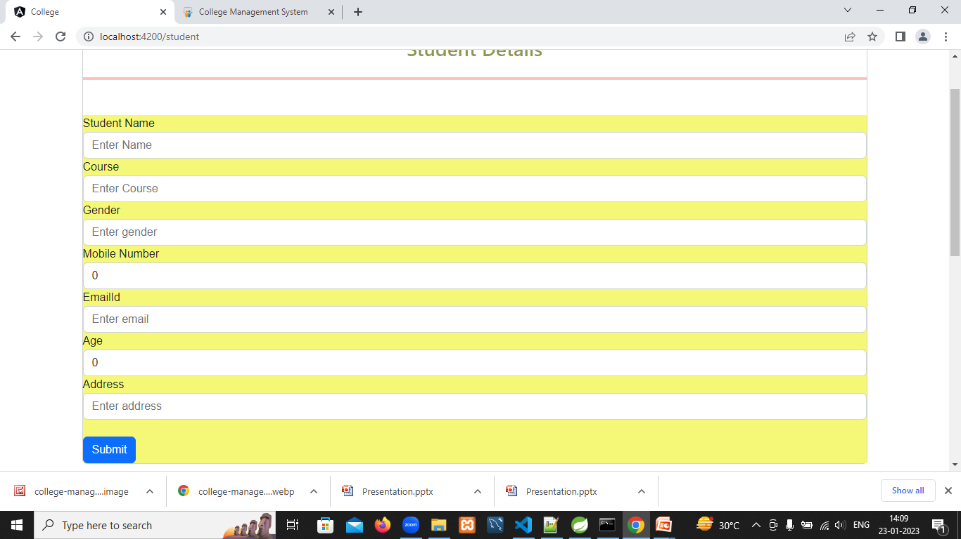
Student Registration Form:

Slide 6
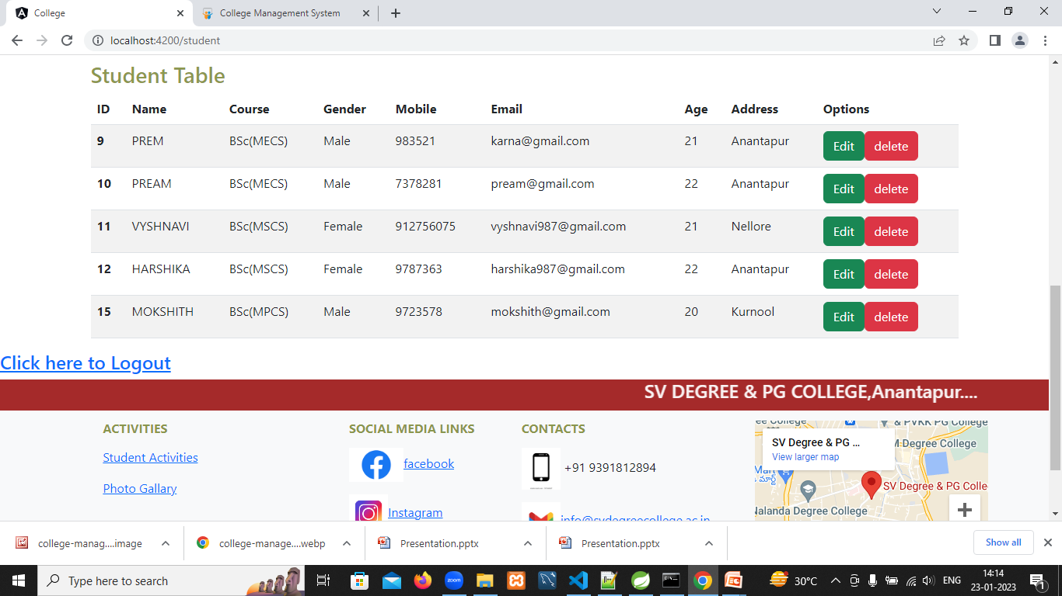
Students List:

Slide 7
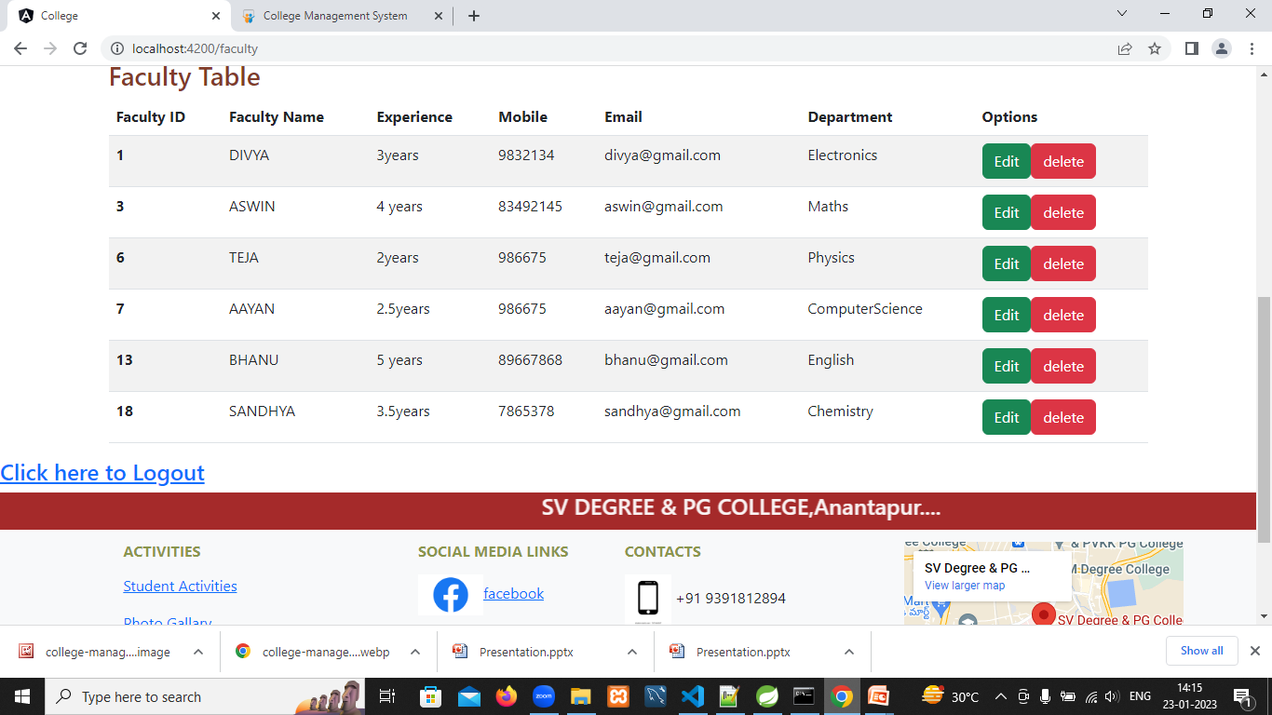
Faculty List:

Slide 8
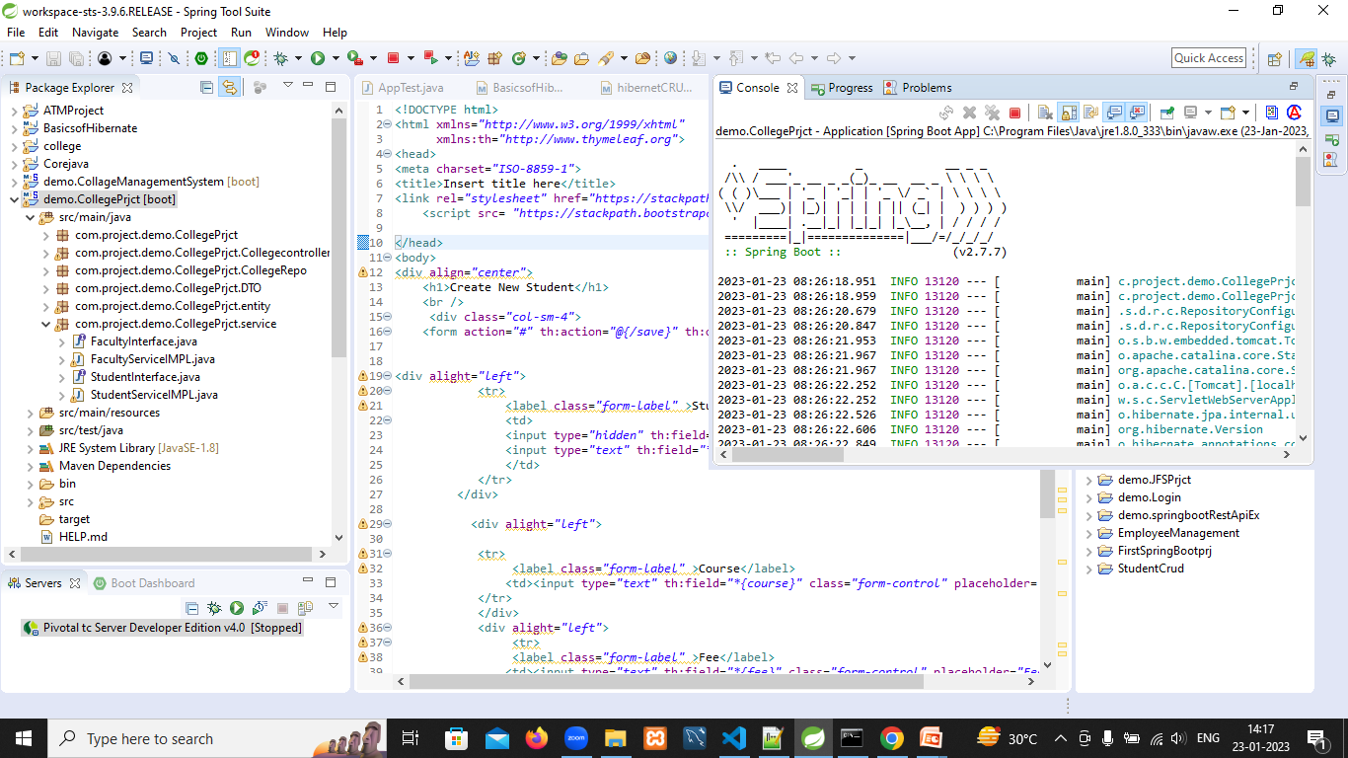
Java Code:

Slide 9
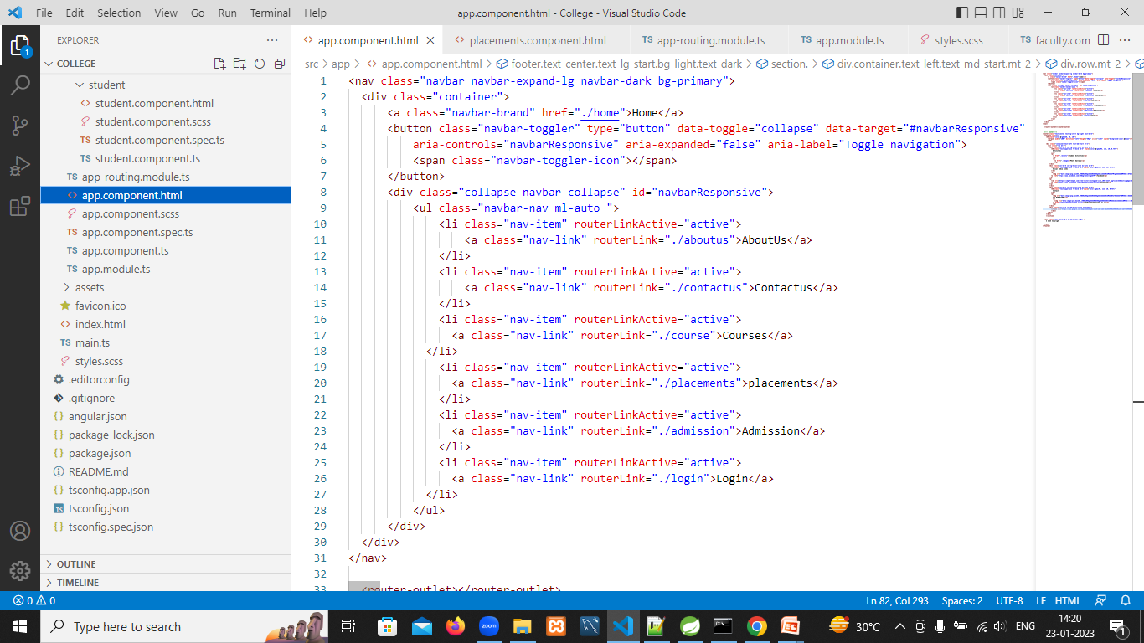
Header Code:

Slide 10
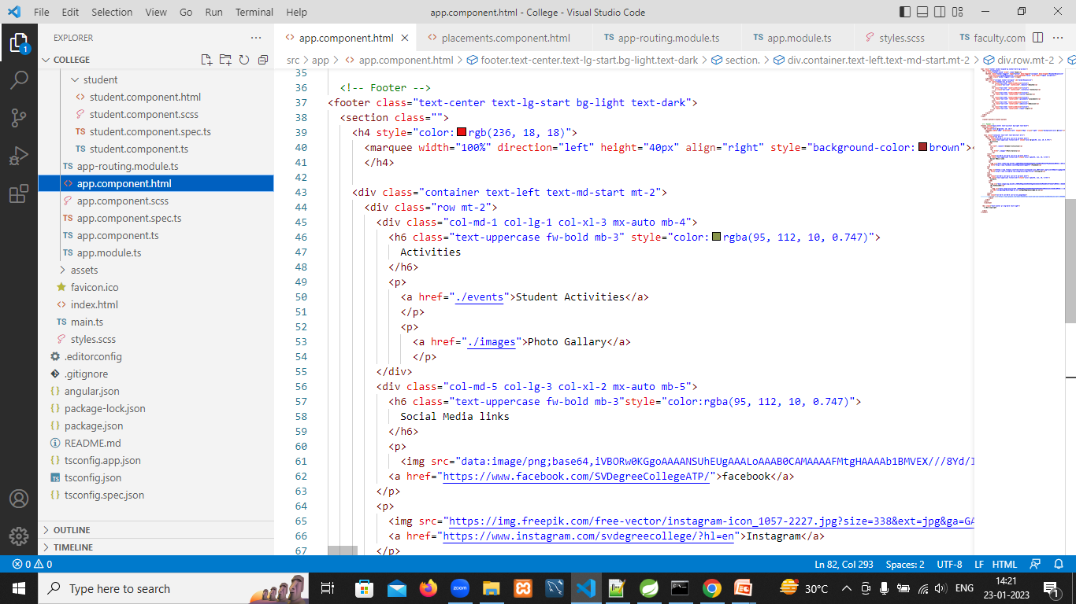
Footer Code:

Slide 11
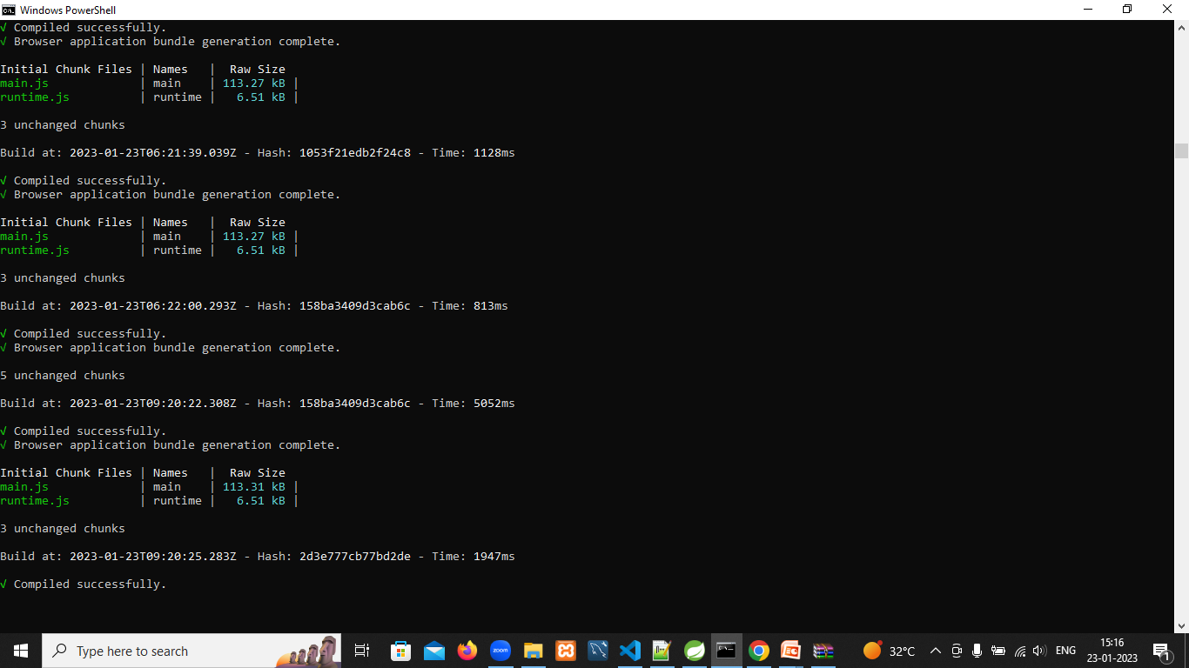

Slide 12


